Slide 1


Slide 2
COMPUTER BASICS

Slide 3
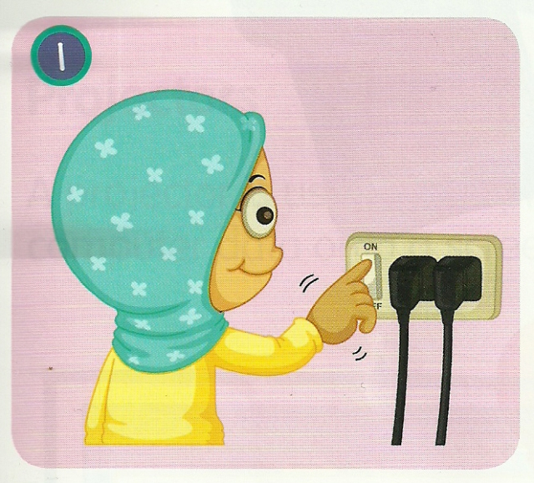
Lets begin with how to start a computer
1. Plug in your computer and all peripheral and switch on the button.

Slide 4
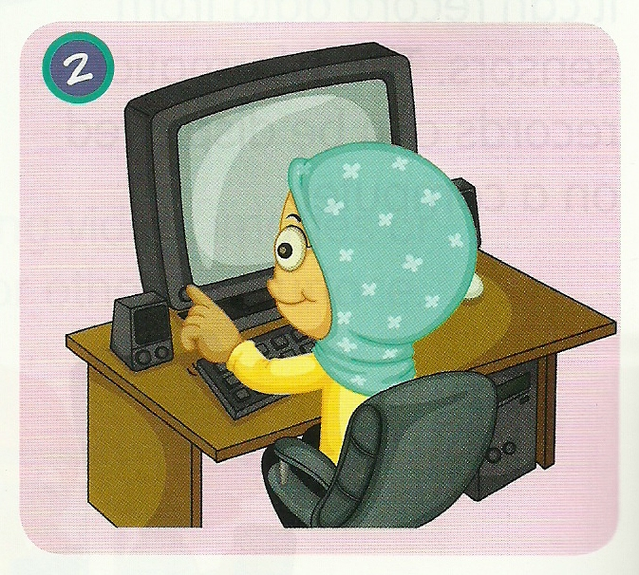
2. Switch On your monitor screen.

Slide 5
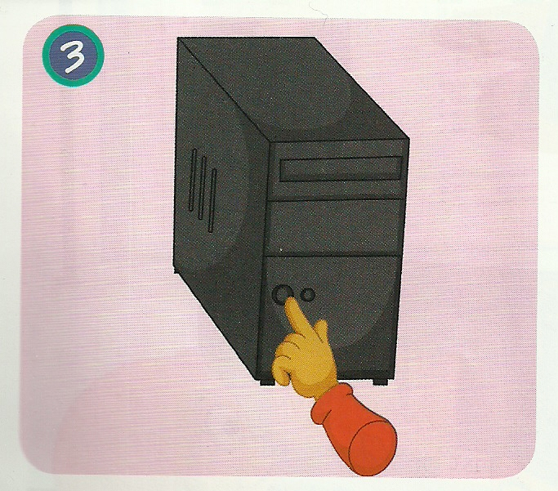
3. Press power button of your CPU then computer will be boot up.

Slide 6
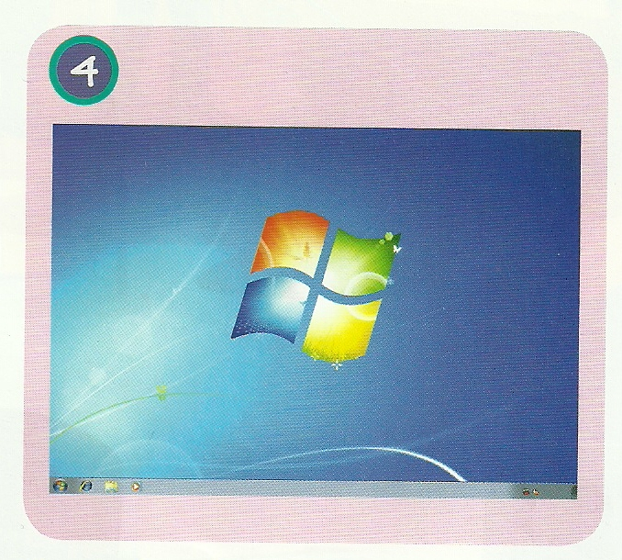
4. Computer will start and you will be see the screen as shown in figure.

Slide 7
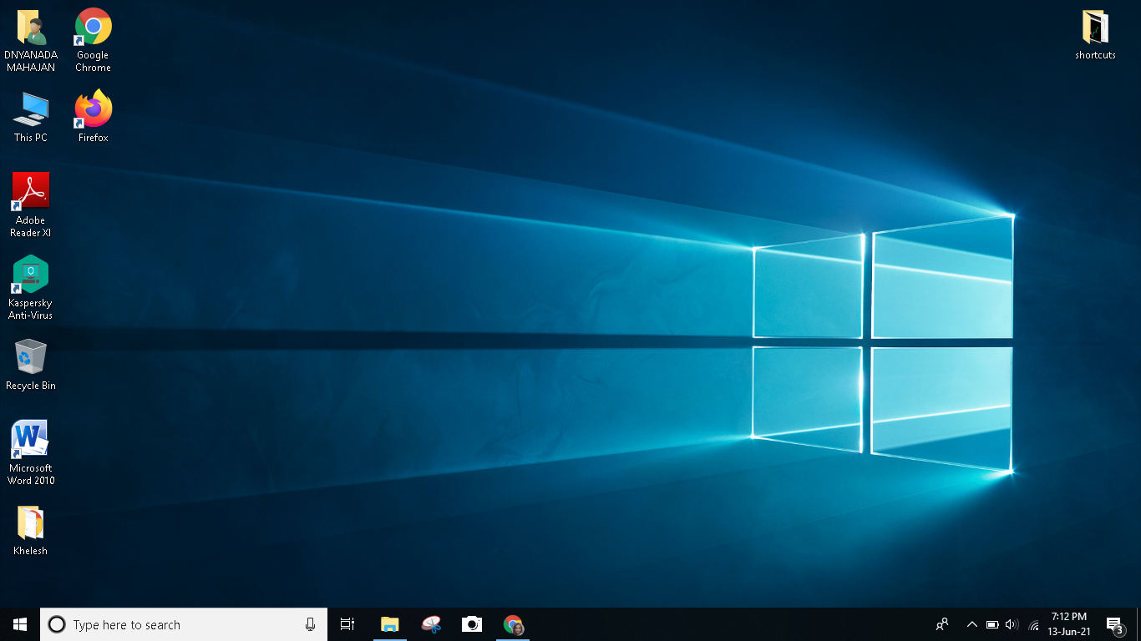
Desktop icons
Taskbar
Notification area
Start
Search box

Slide 8
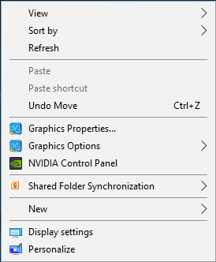
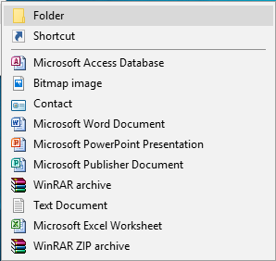
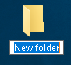

How to create a folder ?
Right click on the screen.
Click on new -> folder
Name the folder whatever you want using keyboard, by clicking inside the box.
Once you finished typing the name press enter key present on keyboard and your folder is ready.

Slide 9

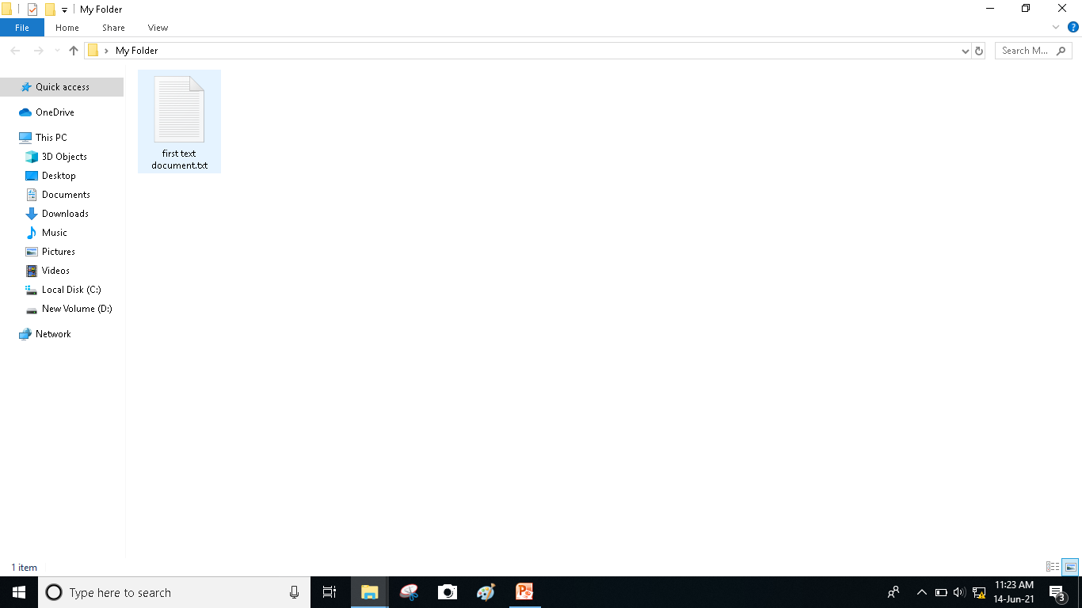

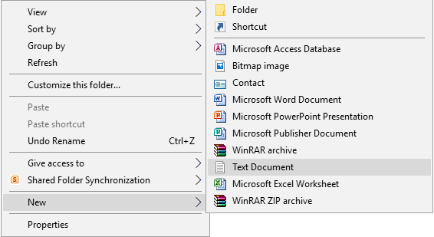
How to create a simple text document inside the folder created ?
To open the folder double click on the folder you have created
At any point on the screen right click go to new -> text document and click on it.
Now rename your document, similarly as we have done for folder.

Slide 10

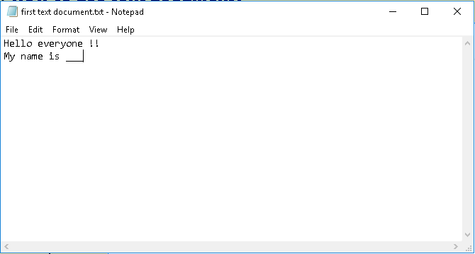
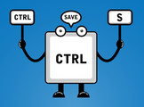
How to use text document?
Double click on the text document you have created.
Type whatever you want by using keyboard.
After you finish typing save the document by going to file -> save
Or else press Ctrl + S key.

Slide 11

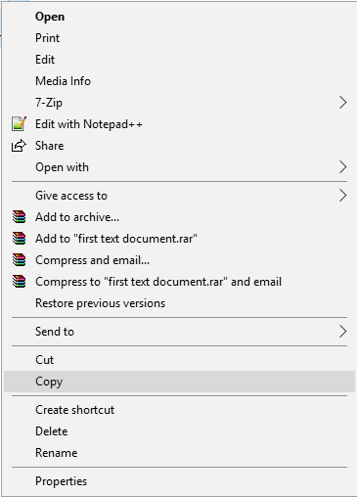
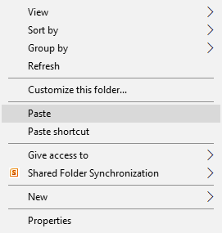
How to copy paste the text document?
1st way:
1. Right click on the text document
2. Click on copy option.
3. Open the folder you want the copy the file and right click on the screen.
4. Click the paste option and you are done.

Slide 12
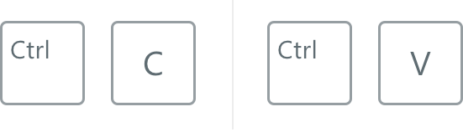
2st way:
1. Single click on the text document
2. Press ctrl + C (to copy a file).
3. Open the folder in which you have to copy the file.
4. Press ctrl + V (to paste file) and your file is copied.

Slide 13

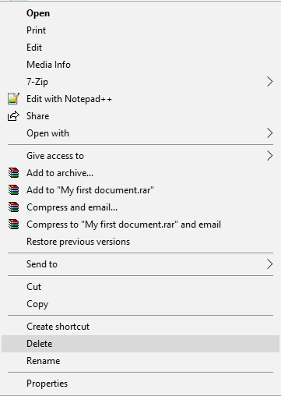
How delete the text document ?
1st way:
1. Right click on the text document.
2. Click on delete option and the document will be deleted.

Slide 14
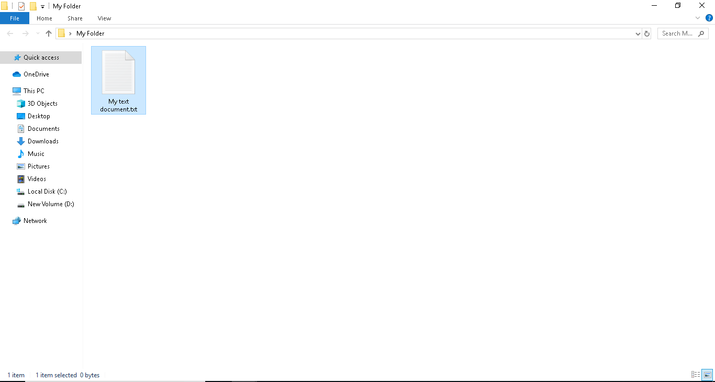
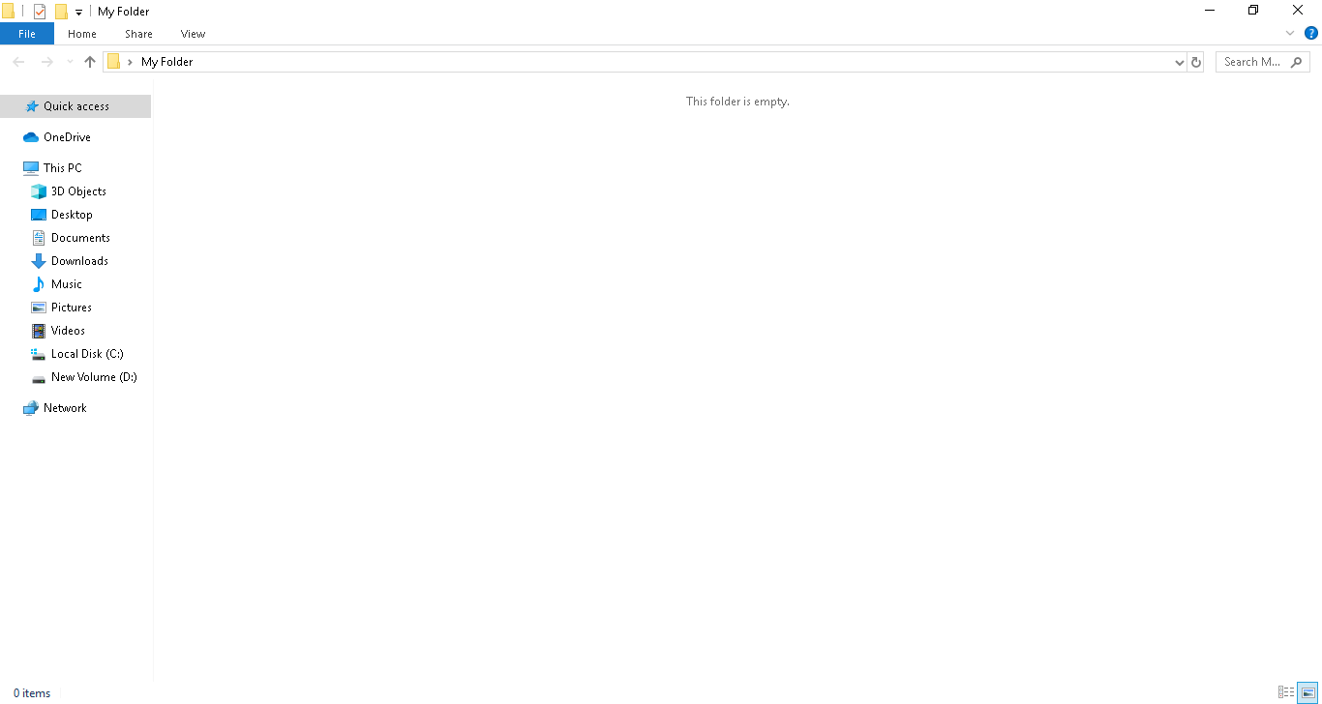
2st way:
1. Single click on the text document.
2. Press the delete button on the keyboard.

Slide 15

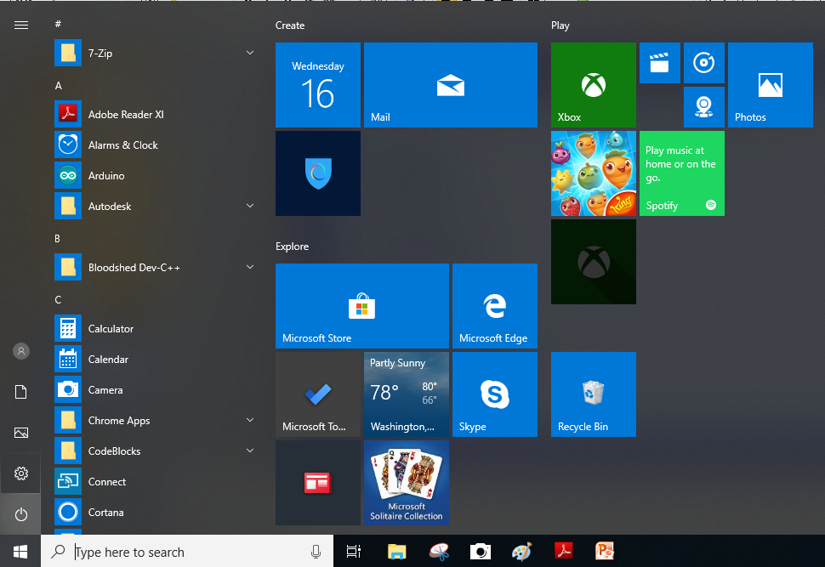
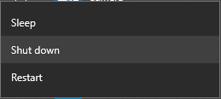
How to close(shutdown) a computer ?
Close all the programs you have opened.
Click on start button and then click on power button.
You will get 3 options – sleep, shutdown and restart amongst which press the shutdown button.

Slide 16

How to restart a computer ?
Rebooting or restarting your system is a troubleshooting process that takes your system through the shutdown process and then starts it back up again.
Click on start -> power -> restart, to restart a computer

Slide 17


